Slide 1
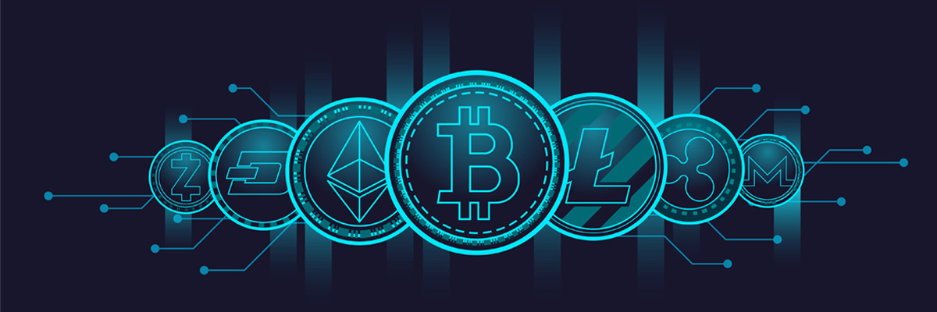
Mining process in Cryptocurrency
using Blockchain Technology

Slide 2
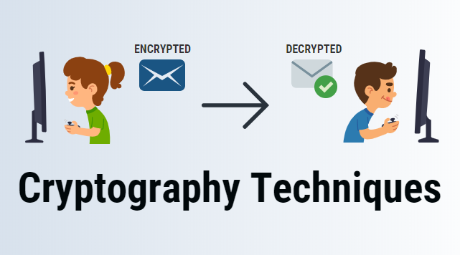
Introduction
What is Cryptography?
Cryptography is a method of using encryption and decryption to secure communication in the presence of third parties with ill intent—that is, third parties who want to steal your data or eavesdrop on your conversation.
Cryptography uses computational algorithms such as SHA-256, which is the hashing algorithm that Bitcoin uses; a public key,which is like a digital identity of the user shared
with everyone;and a private key, which is a digital signature of the user that is kept hidden.

Slide 3


What is Cryptocurrency?
A cryptocurrency is a digital or virtual currency that is meant to be a
medium of exchanges.
It is quite similar to real-world currency, except it
does not have any physical embodiment, and it uses cryptography to
work.
What is Blockchain?
Blockchain is a system of recording information in a way that
makes it difficult or impossible to change, hack, or cheat the
system.

Slide 4

Traditional Currencies Vs Cryptocurrencies
Anonymity
Flexibility
No fraudulent activity
Reduced cost

Slide 5
What means Cryptocurrency mining and Who are the Minors?
Cryptocurrency mining is the process in which transactions between
users are verified and added to the blockchain public ledger.
The process of mining is also responsible for introducing new coins into the existing circulating supply and is one of the key elements that allow
cryptocurrencies to work as a peer-to-peer-decentralized network,
without the need for a third-party central authority.

Slide 6
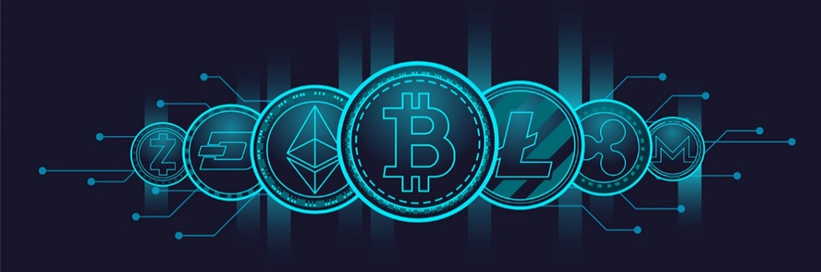
Features of Cryptocurrency
They only exist Digital Environment
2) Operate with decentralized network
3) Part of a Peer-To-Peer network
4) Use Encryption
5) Transaction are permanent Cannot be Undone

Slide 7

Benefits of Cryptocurrency?
International cryptocurrency transactions are faster than wire transfers
too.
Wire transfers take about half a day for the money to be moved
from one place to another. With cryptocurrencies, transactions take only
a matter of minutes or even seconds.

Slide 8
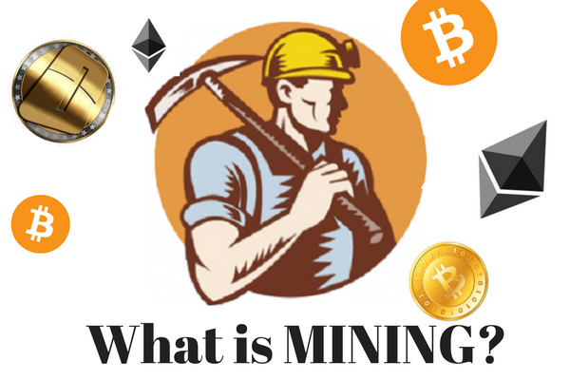
Cryptocurrency Mining and Process
What is Cryptocurrency mining?
The Bitcoin software runs on a powerful computer called node.
It also helps in transmitting the information over the distributed network.
The transactions are propagated over the network through nodes which are known to it, which in turn will spread it further
The mining is the process of finding the valid block.
Anyone who has access to internet can become a miner.

Slide 9

What is Cryptocurrency mining?
Miners are competing with each other to find the desired solution, which is based on the cryptographic puzzle.
Once the desired solution is found, the miner adds the block to the blockchain.
The miner in turn is rewarded by certain number of Bitcoins.
Bitcoin can be generated if and only of the miner solves the cryptographic puzzle.
The difficulty of solving the puzzle increases and the reward in term of Bitcoin decreases over the period.
The number of Bitcoin that can be generated in a given amount of time cannot exceed a specific amount.
The more the hardware capability to solve the puzzle, the more will be the cost of mining

Slide 10

Steps to Mining
The miner collects all transactions broadcasted over the distributed network.
The transactions are checked and verified.
The most recent block on the longest path is selected on the blockchain.
The miner solves the Proof of Work and the solution is broadcasted to all the nodes in the network.
The above steps are repeated. Any transaction not included in the block are saved for next cycle.
Mining Pools
Mining pools are created to solve this problem.
It means pooling of resources by miners, who share their processing power
over a network, to split the reward equally among everyone in the pool,
according to the amount of work they contribute to the probability of
finding a block.

Slide 11
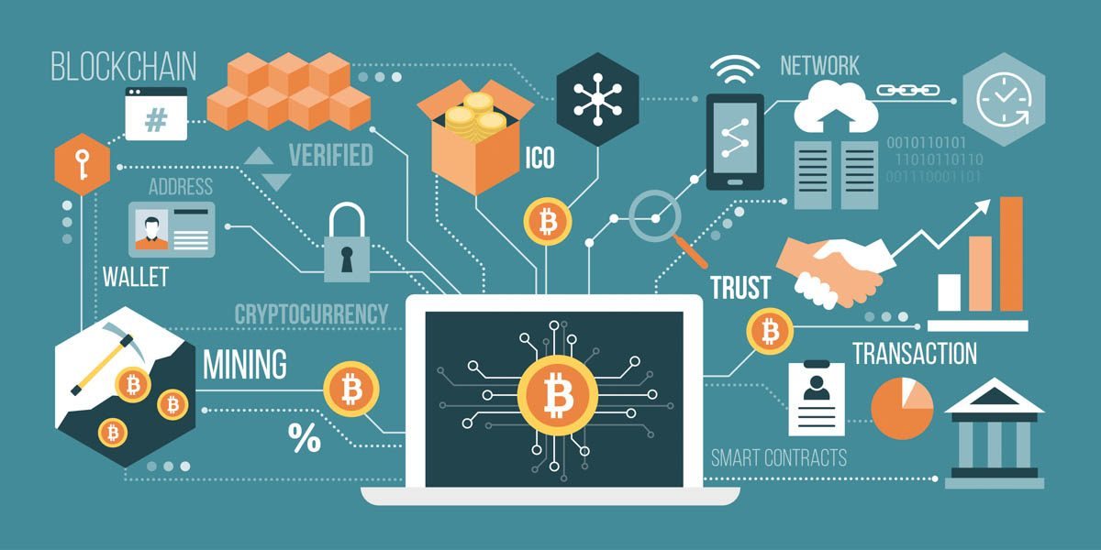
Conclusion and Future
Future of Cryptocurrency
The world is clearly divided when it comes to cryptocurrencies.
On one side are supporters such as Bill Gates, Al Gore and Richard Branson, who say that cryptocurrencies are better than regular currencies.
In the future, there’s going to be a conflict between regulation and anonymity.
Since several cryptocurrencies have been linked with terrorist attacks, governments would want to regulate how cryptocurrencies work.
The main emphasis of cryptocurrencies is to ensure that users remain anonymous.

Slide 12
THANK YOU!

